Slide 1
IOT HOME AUTOMATION

Slide 2
TOPICS COVERING
INTRODUCTION
OBJECTIVE
INTERNET OF THINGS
HOME AUTOMATION
CIRCUIT DIAGRAM
FLOW CHART
WORKING PROCESS
CONNECTION
FUTURE SCOPE
CAUTION
CONCLUSION

Slide 3
INTRODUCTION
CONCEPT OF HOME AUTOMATION
OUR POINT OF VIEW
COMPONENTS CAN BE USED
USAGE IN REAL WORLD

Slide 4
OBJECTIVE
SECURITY
CONTROL
ACCESS
CONNECTION

Slide 5
INTERNET OF THINGS
Internet of Things
Internet connected objects (things) working together to solve a business problem
Has been around for quite a while, but only recently has become affordable for personal use
Notes:
It isn’t coming soon .. it is already here and has been so for quite a while
Connects billions of sensors and devices from every day consumer objects to industrial equipment

Slide 6
HOME AUTOMATION USING IOT
AUTOMATED BY INTERNET
EASY TO MAINTAIN AND OPERATED WITH EASE
SAVES ENERGY AND COST
EASILY AVAILABLE
Notes:
Provide intelligence
Improve efficiency

Slide 7
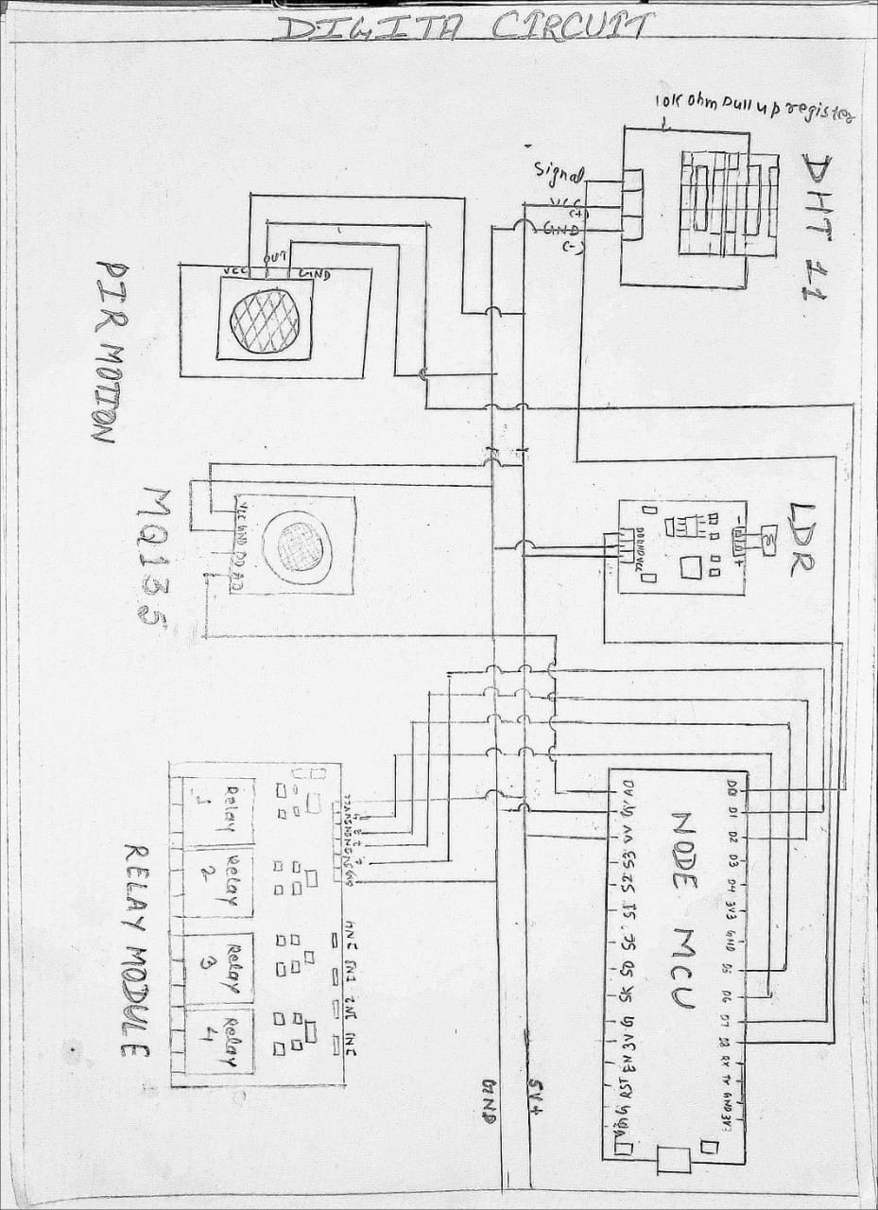
CIRCUIT DIAGRAM

Slide 8
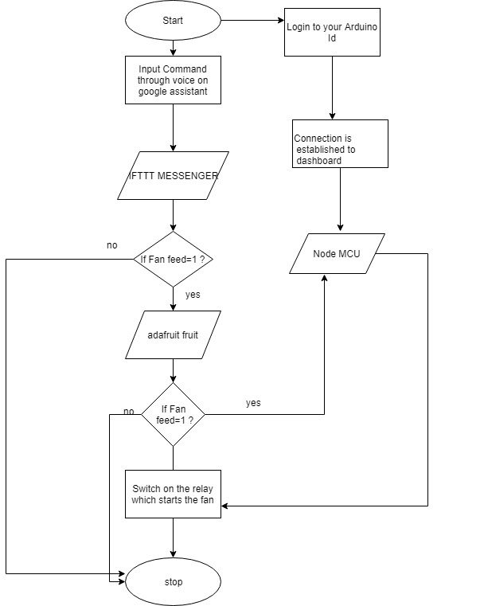
FLOW CHART

Slide 9
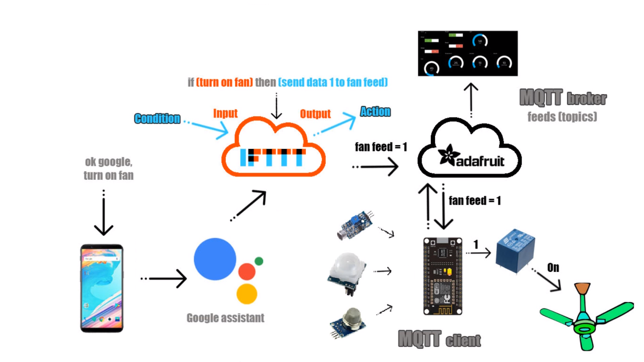
WORKING PROCESS

Slide 10
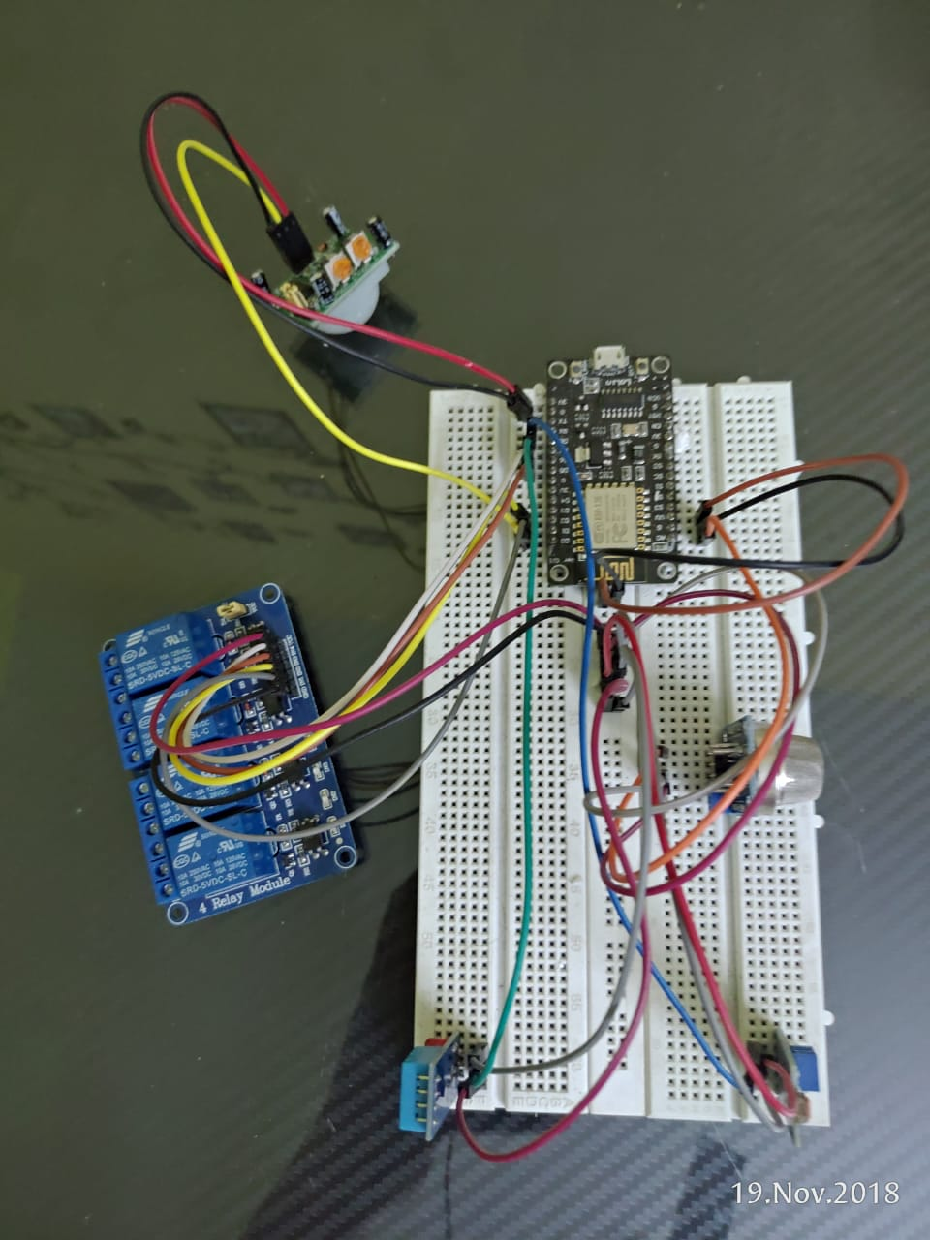
CONNECTION

Slide 11
FUTURE SCOPE
TURNING ORDINARY ELECTRONIC HOME APPLIANCES INTO SMART HOME APPLIANCES
OPERATING THROUGH OWN SERVER
GIVING ACCESS TO LIMITED PEOPLE
CONVERTING INTO A PRODUCT

Slide 12
CONCLUSION
SYSTEM HELPING TO OPERATE HOME FROM ANYWHERE
UNIQUE ID AND PASSWORD ENSURES SECURITY
SYSTEM TO MAKE APPLIANCES SMART
MINIMAL REQUIREMENT IS INTERNET

Slide 13


